Slide 1


ELECTRICITY CONSUMPTION PREDICTION
Nirant Kale | Machine learning Intern
A project by mentorness
Notes:
Hey everyone,
ELECTRICITY CONSUMPTION PREDICTION
An intern project by Mentorness aims to predict future household electricity consumption
Myself Nirant am a ML intern at mentorness and will be guiding you through this presentation.
Lets go through the contents

Slide 2
TABLE OF CONTENTS
INTRODUCTION TO PROJECT | ELECTRICITY CONSUMPTION PREDICTION | PREREQUISITES
APPROACH | STRATEGY | PLANNING | EXPECTED OUTCOME
IMPLEMENTATION | CLEANING & PREPROCESSING | EDA | MODEL DELEVOPEMENT
OUTCOMES | PREDICTION | VISUAL RESULTS
FUTURE PLAN & SCOPE | IMPROVEMENTS IN MODEL
CONCLUSION | THANKS GIVING | APPRECIATION
Notes:
We’ll have an introduction to the project discussing its objectives, & prerequisites
Moving to APPRoach the workflow,strategy ,expected outcomes will be discussed.
In the implementation part
data cleaning & preprocessing
EDA
model will be developed
In the outcomes section ,
we would visualize the results
Further the we’ll have an overview on future plans & scope

Slide 3
01
INTRODUCTION TO PROJECT
Notes:
Let’s get started with Introduction

Slide 4
INTRODUCTION
The goal is to make a model which forecasts Household power consumption based on historical data using models like ARIMA, SARIMA or LSTM.
We have a dataset in text format with columns as :
Date, Time, Global_active_power, Global_reactive_power,
Voltage, Intensity, Sub_metering_1, Sub_metering_2 & Sub_metering_3.
Initially all are of type Object except Sub_metering_3 is of type float.
Notes:
Our main goal
Columns as shown here
Major of them are object & one is float type

Slide 5
OBJECTIVES
Data Preprocessing:
Cleaning & handling missing values
Exploratory Data Analysis (EDA)
Plot graphs for visualization
Time Series Forecasting Models
Choose & train model
Feature Engineering
Derive significant features that may enhance model precision
Model Evaluation and Tuning
Adjust the input parameters, data sizes, etc.
Future Consumption Prediction
Notes:
Objectives to be achieved are

Slide 6
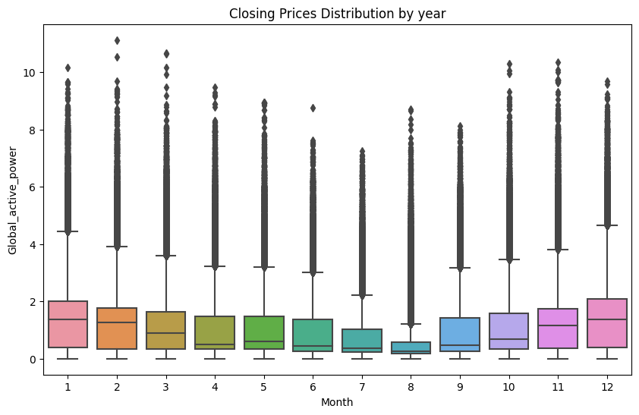
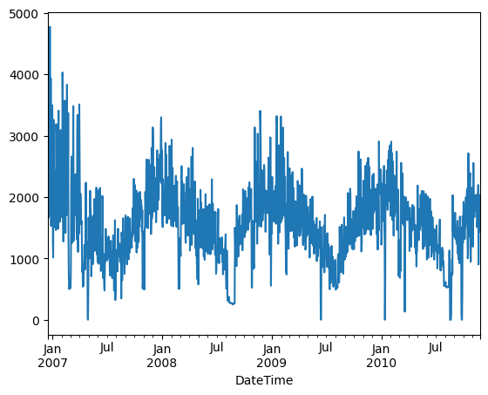
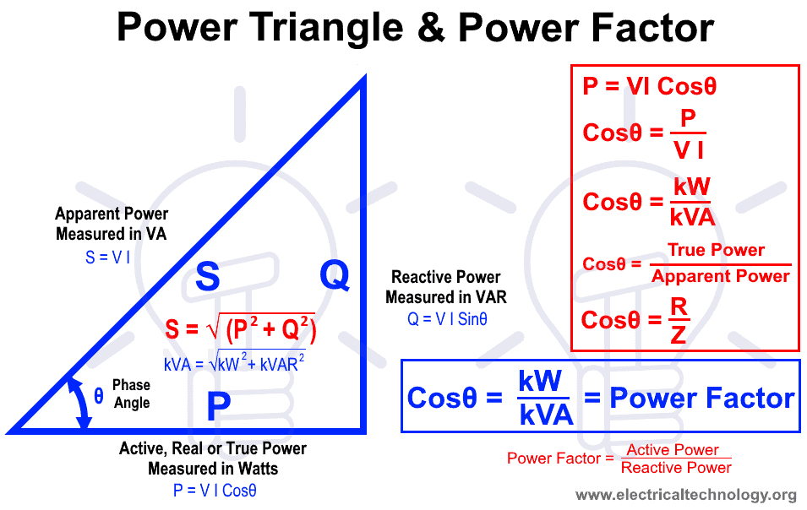
PREREQUISITES
Visualizing Graphs
Basics of electricity calculations
Notes:
Here are some prerequisites in order to understand the process

Slide 7
02
APPROACH
Notes:
In this section we will be discussing the APPROACH that is workflow & what do we expect as outcome of this project

Slide 8
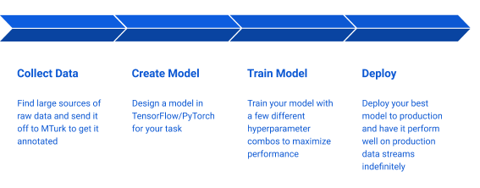
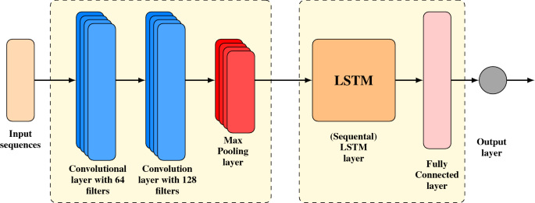
WORKFLOW
Notes:
WE have used a stacked lstm model to forecast the electricity consumption as shown in figure we give an input sequence to the model which goes through multiple layers convolution & cooses a max pooling layer that is a point where it decides what should be the output & further provides the output.

Slide 9
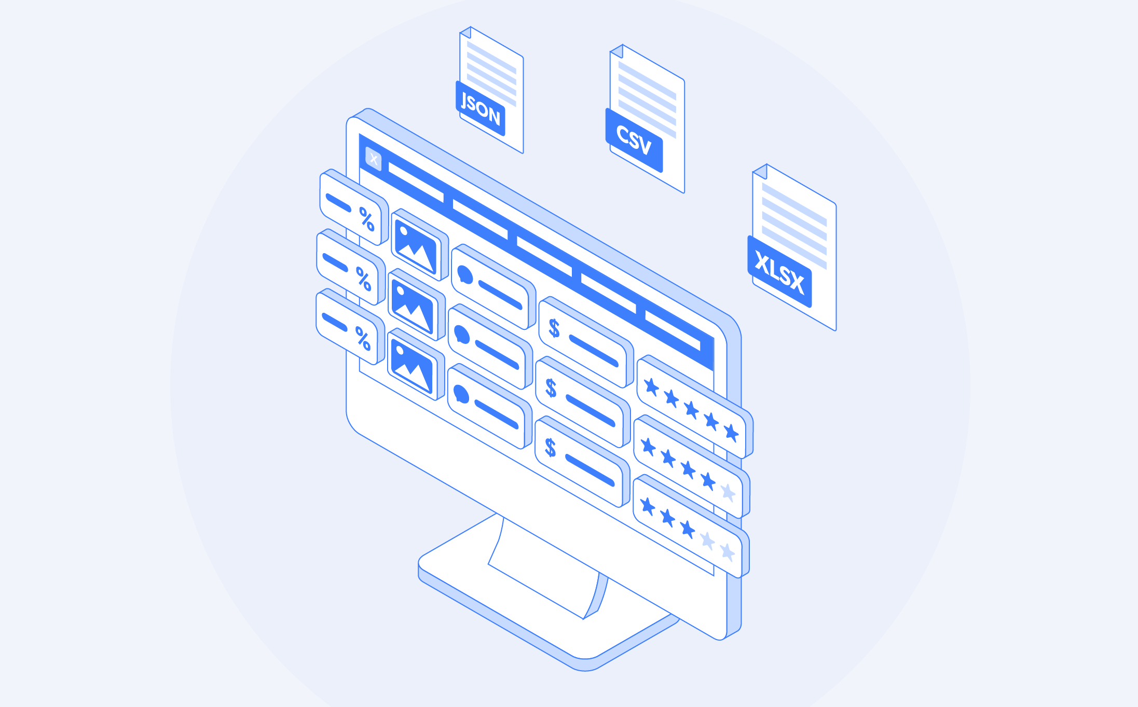
EXPECTED OUTCOMES
CLEANED DATASET
A FEATURE TO SHOW OVERALL POWER CONSUMPTION
A MODEL WHICH PREDICTS A SPECIFIC AMOUNT OF DAYS ELECTRICITY CONSUMTION
Notes:
Our desired outcomes are

Slide 10
03
IMPLEMENTATION
Notes:
The main part of project that is implementation
The most of this part is about visualizing things
starting with cleaning & preprocessing the data

Slide 11
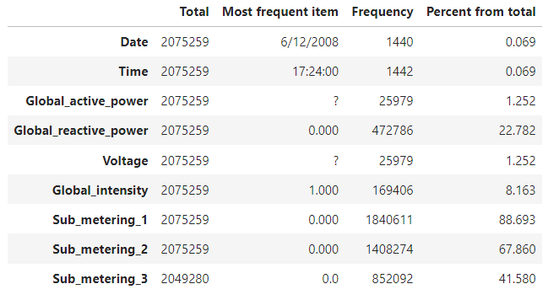
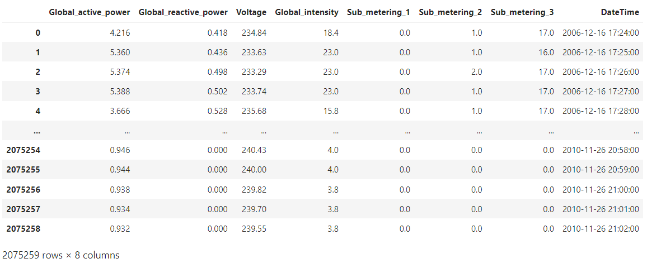
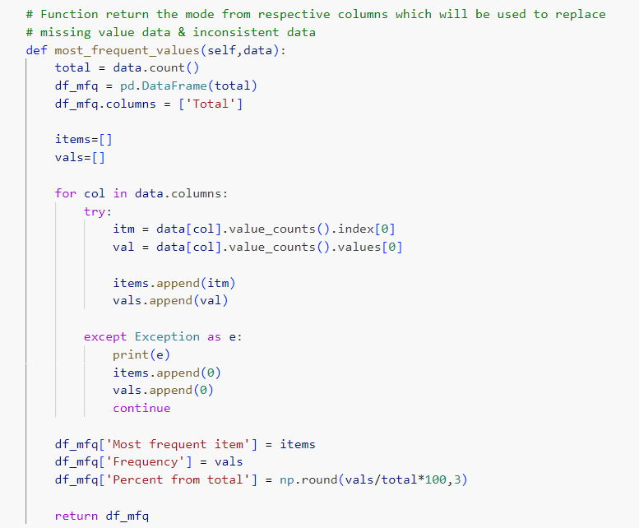
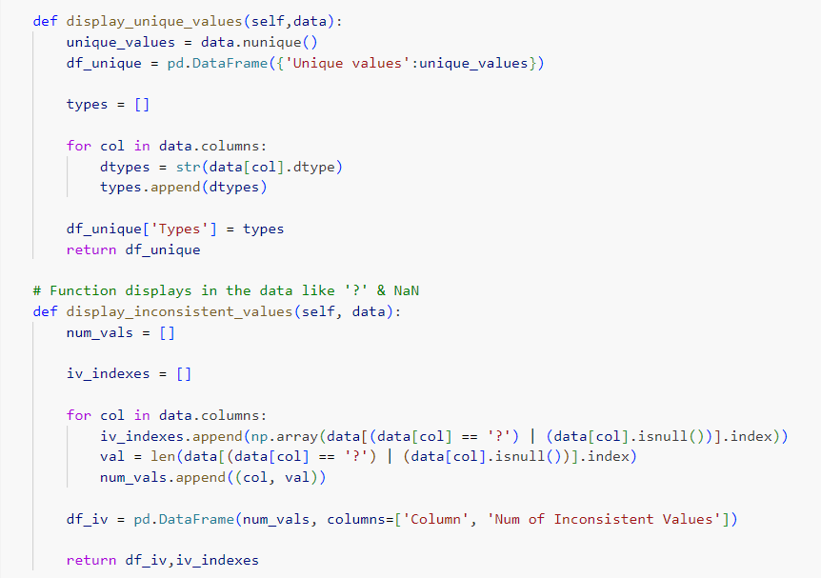
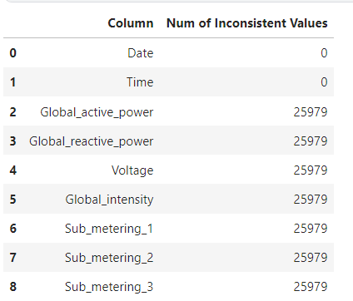
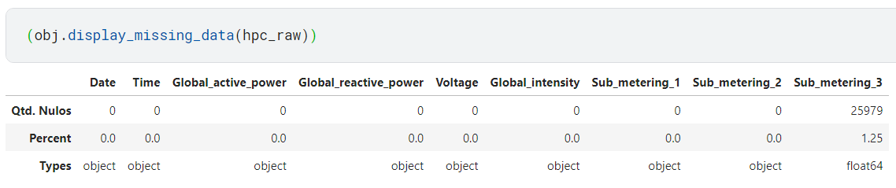
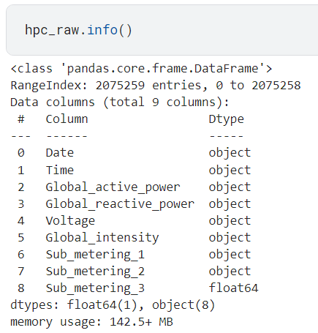
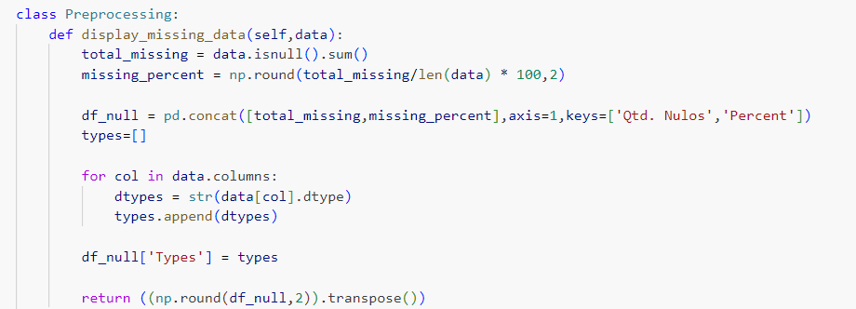
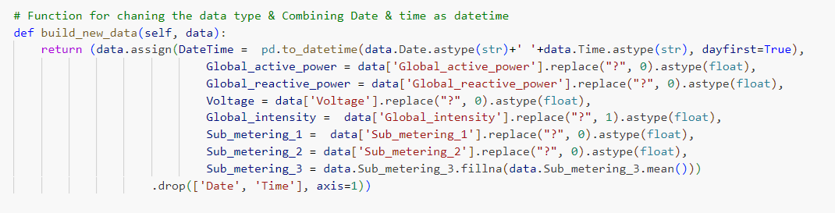
CLEANING & PREPROCESSING
Let’s First understand our data:
BY INITIATING A CLASS PREPROCESSING WITH CLEANING FUNCTIONS AS :

Slide 12
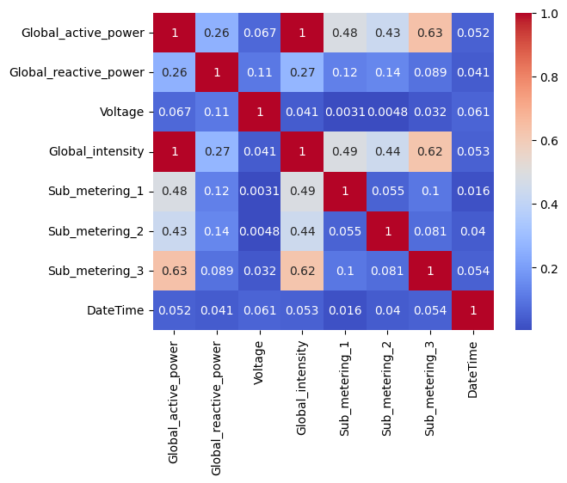
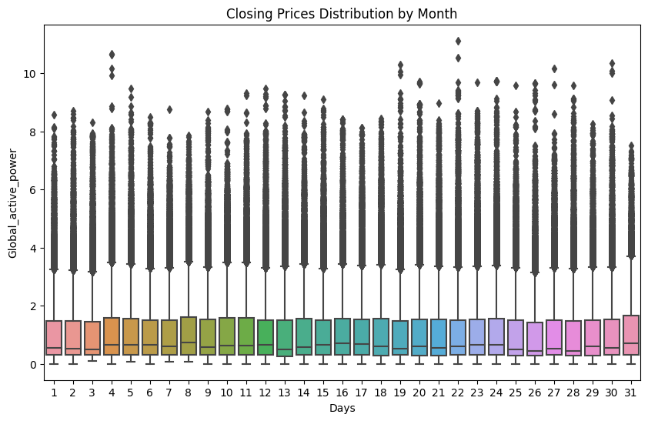
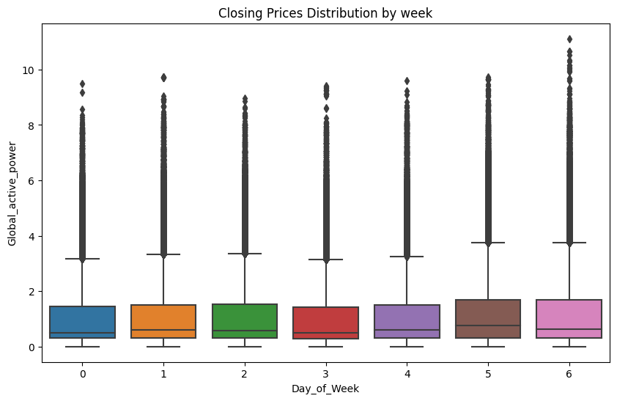
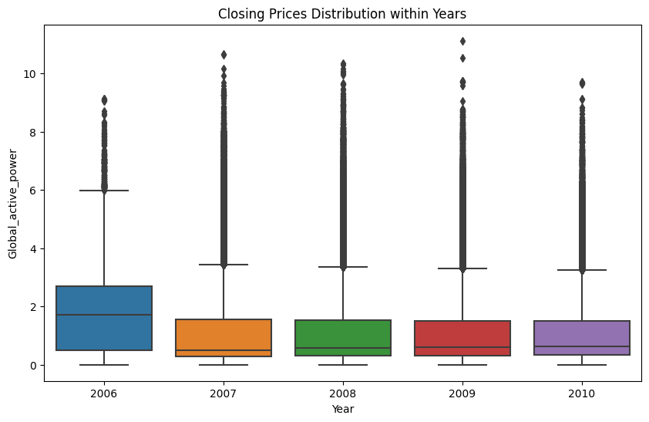
EXPLORATORY DATA ANALYSIS
Notes:
This is how our data actually is upto the stage & how a feature correlates with each other

Slide 13

MODEL DEVELOPMENT
Notes:
To the Core of the implementation phase lies Model development, hand-in-hands with feature engineering

Slide 14
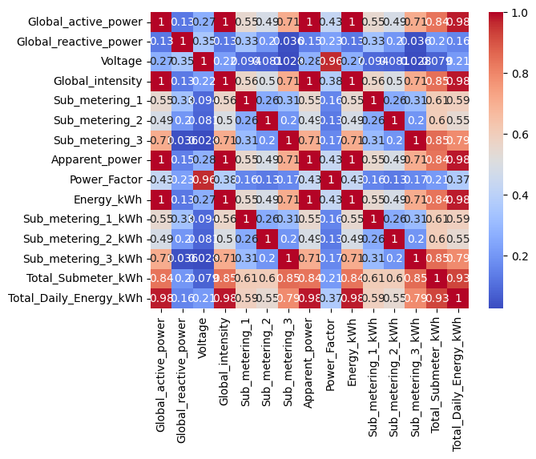
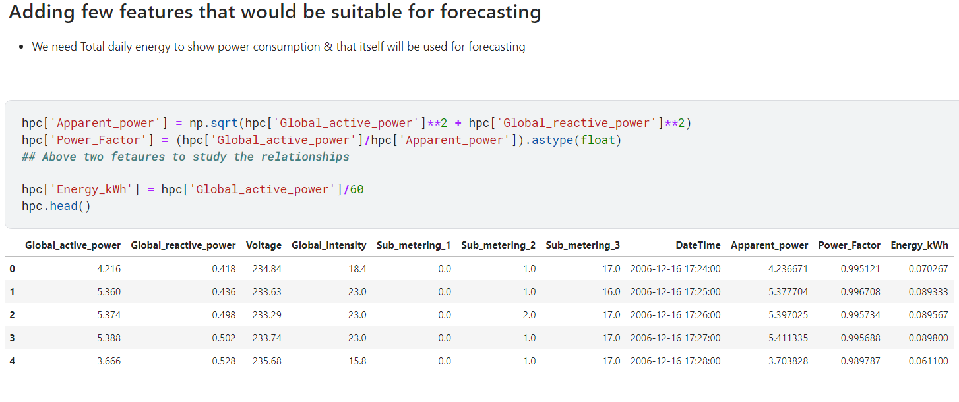
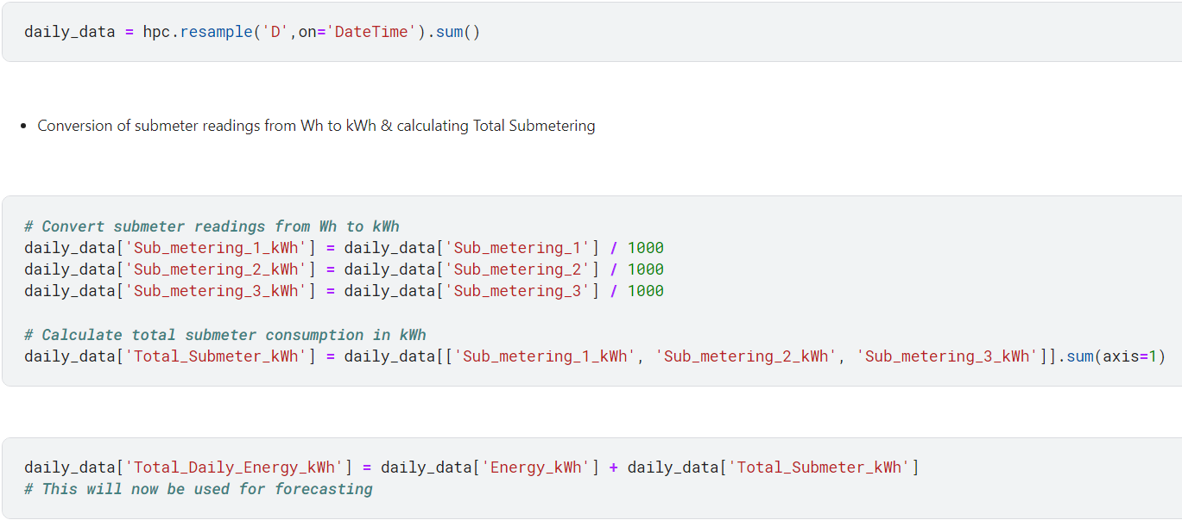
FEATURE ENGINEERING

Slide 15
04
OUTCOMES & FUTURE SCOPE
Notes:
In,

Slide 16
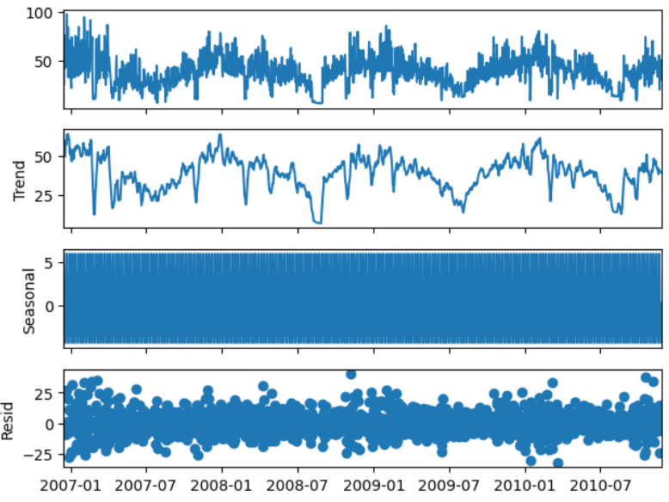
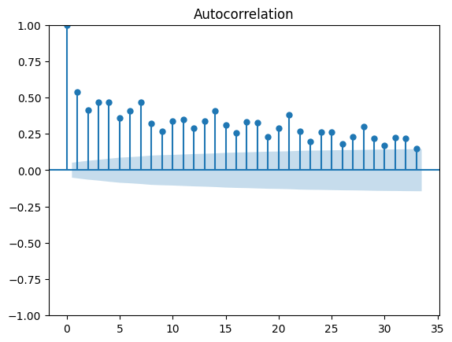
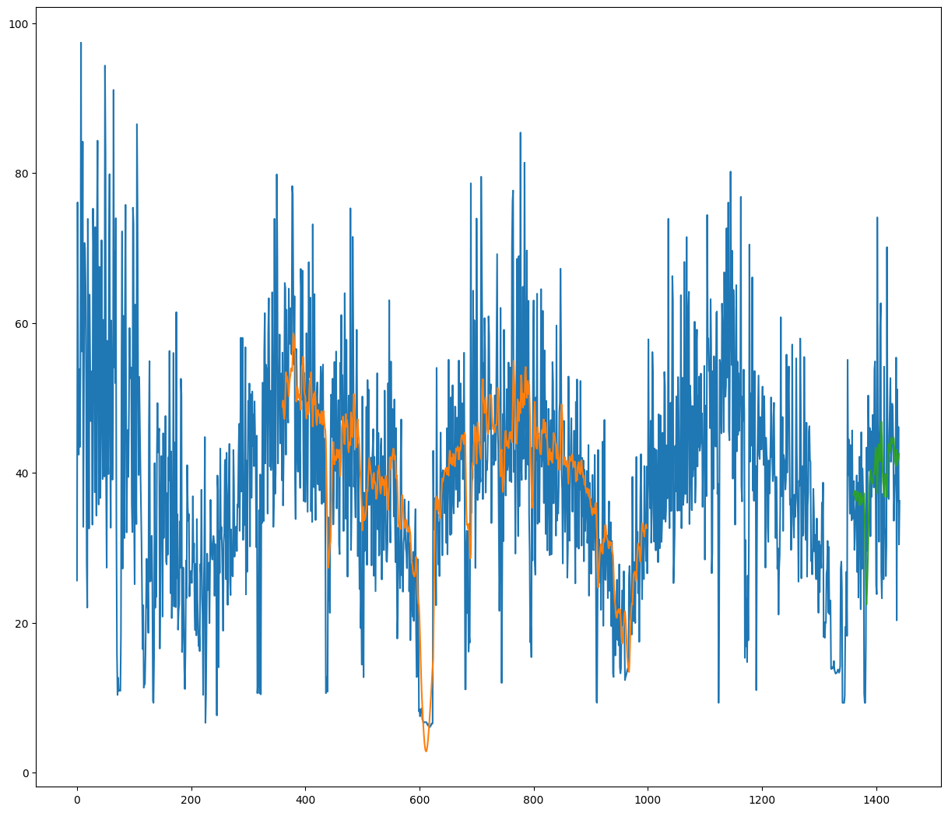
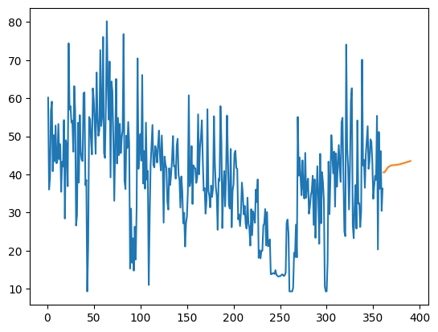
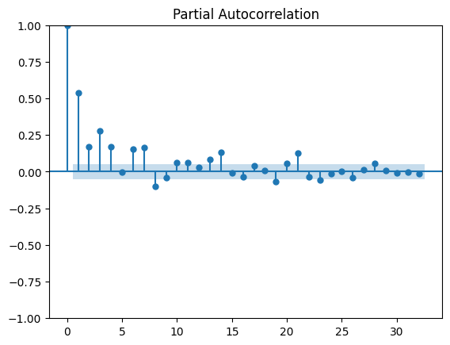
Notes:
Stationary
But also seasonal
So we come at conclusion that lstm also isn’t the best model for forecasting this data but shows a overall trendline for a large number of days also its accurate to show accurate forecasts for the minimum size of data

Slide 17
FUTURE SCOPE
To add more accuracy & precision to the model
Use the whole data (each minute) for forecasting
Try to utilize other models/combination of models
Notes:
We would be aiming to

Slide 18
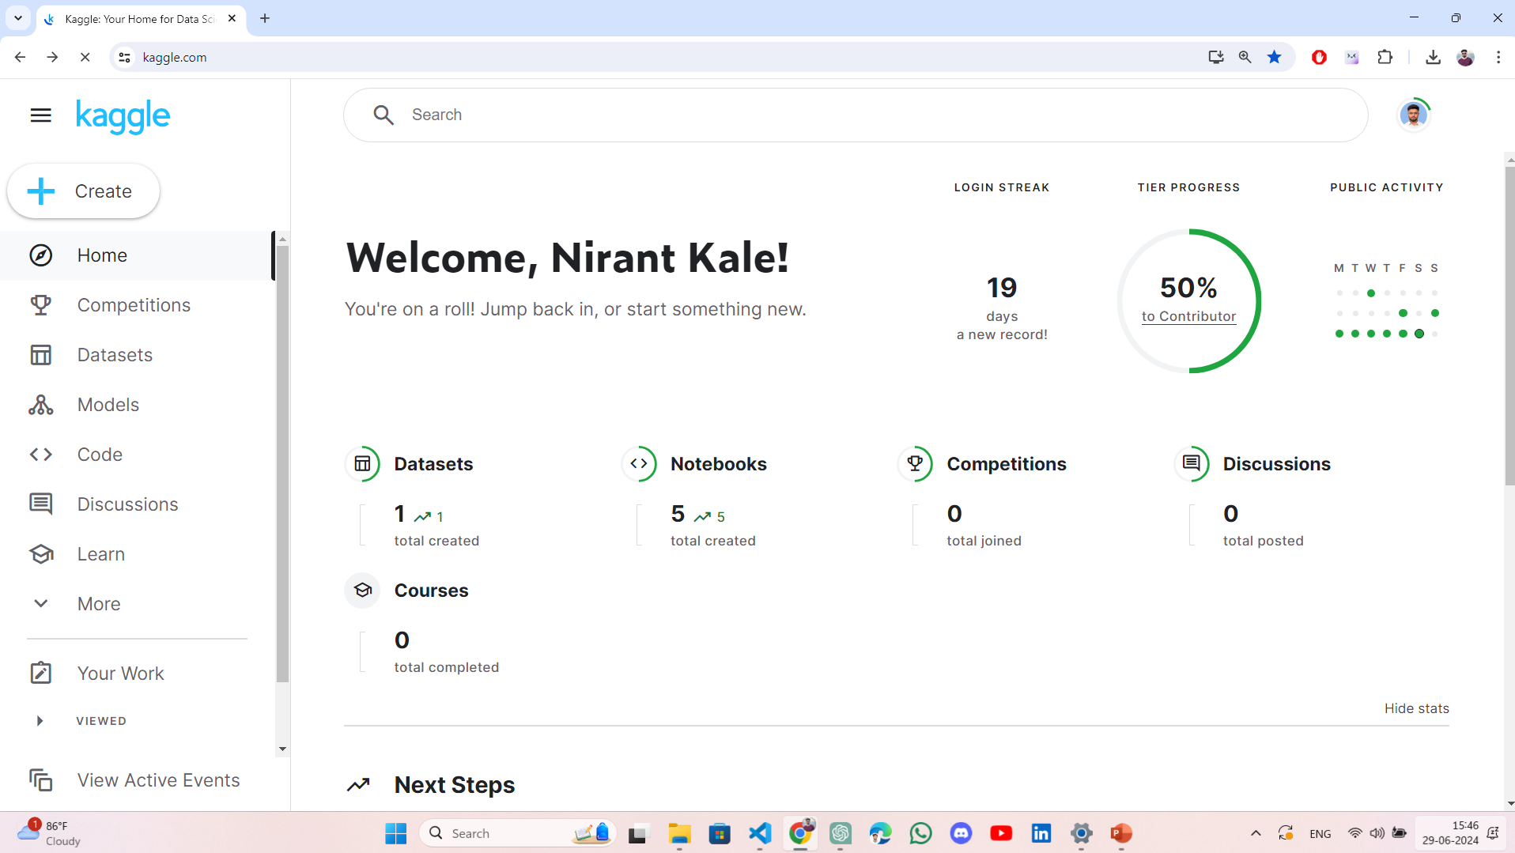
USED SOFTWARE & APP
Notes:
I particularly used Kaggle for this projects it has numerous advantages over a IDE like
It has jupyter notebook
Numerous datasets
Keep track of live python version & current py notebook code that was combinely save as a version

Slide 19

THANKS !
Notes:
So that all about the project thank a lot for your attention

